Slide 1
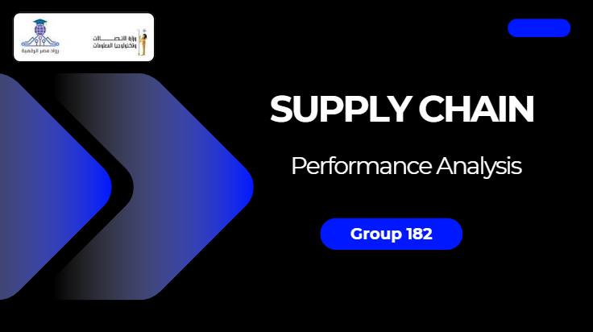

Slide 2
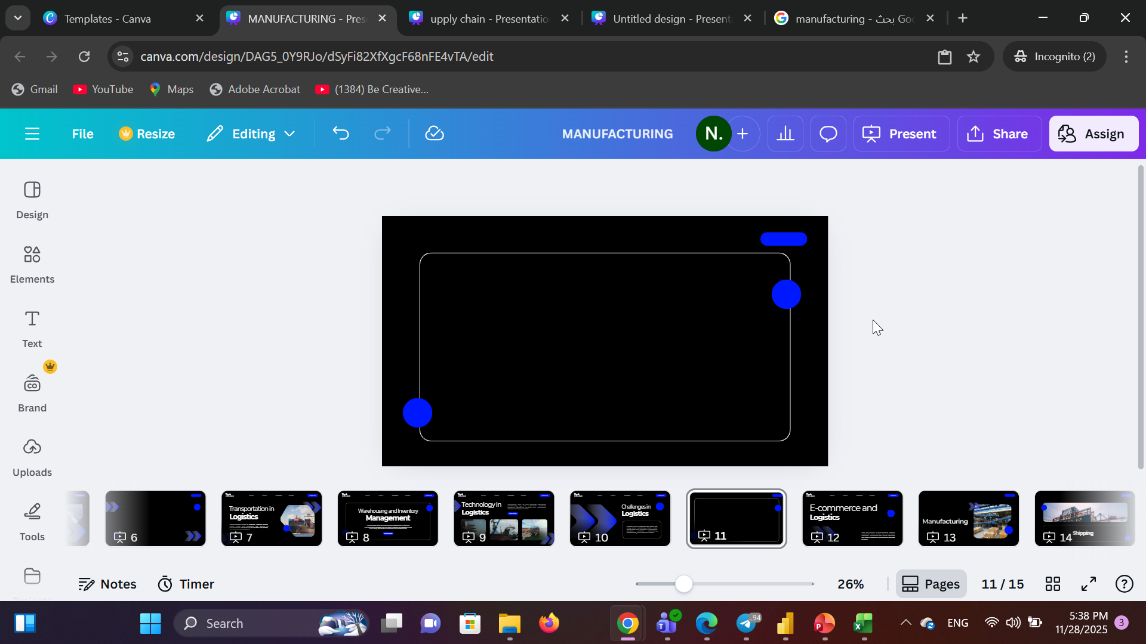
Under supervision of Eng. Abdelrahman Elfarsy
Name | Responsibilities
Nora Gamal Tawakel | Data exploration and pre-processing Manufacturing KPIs and charts. Dashboard design
Fatma Ahmed ElDesoky | Inventory & supply KPIs and charts. Dashboard design
Tokka Hassan Bedir Esraa Ebrahim Saleh | logistics & transportation KPIs and charts. Dashboard design
Batool Ayman Mohamed | Consumption KPIs and charts. Dashboard design

Slide 3
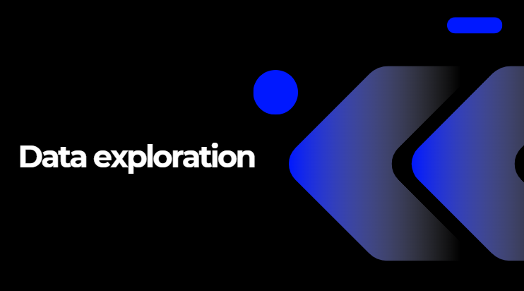
Project Overview

Slide 4
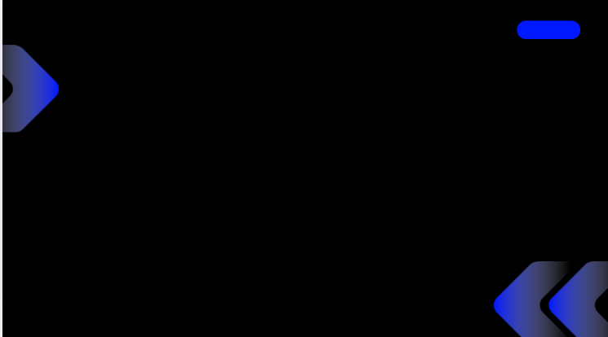
The project aims to design and develop a comprehensive Power BI analytics solution for monitoring and optimizing Supply chain.
It integrates data from manufacturing, inventory & supply, logistics& transportation, and Consumer to deliver data-driven insights for improving plant reliability, operational efficiency, and cost control

Slide 6
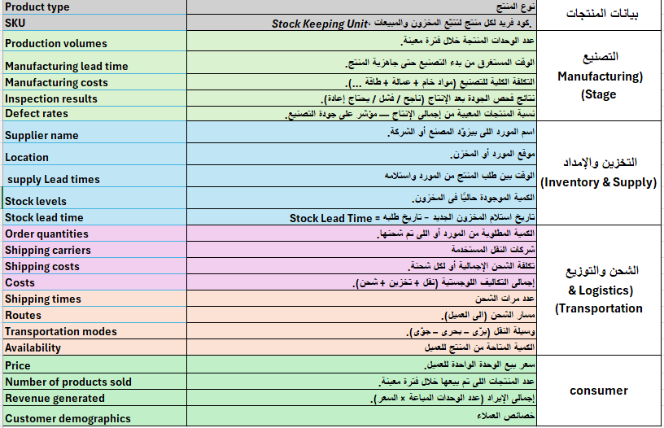
1 table / 24 column /100 row + header
Meta data

Slide 7


Slide 8
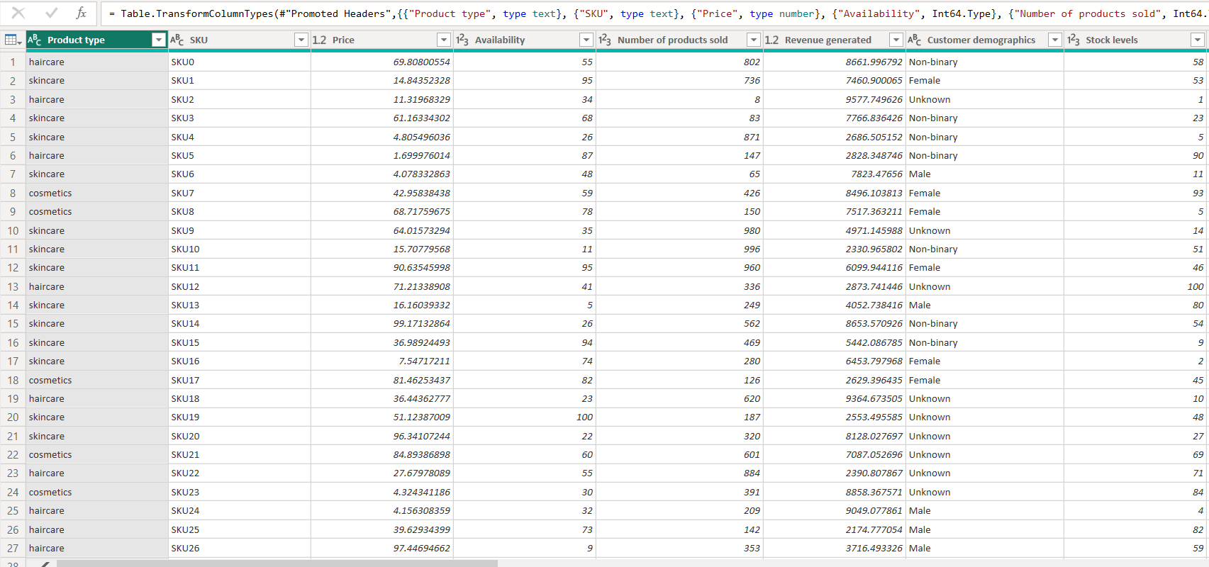

Slide 9
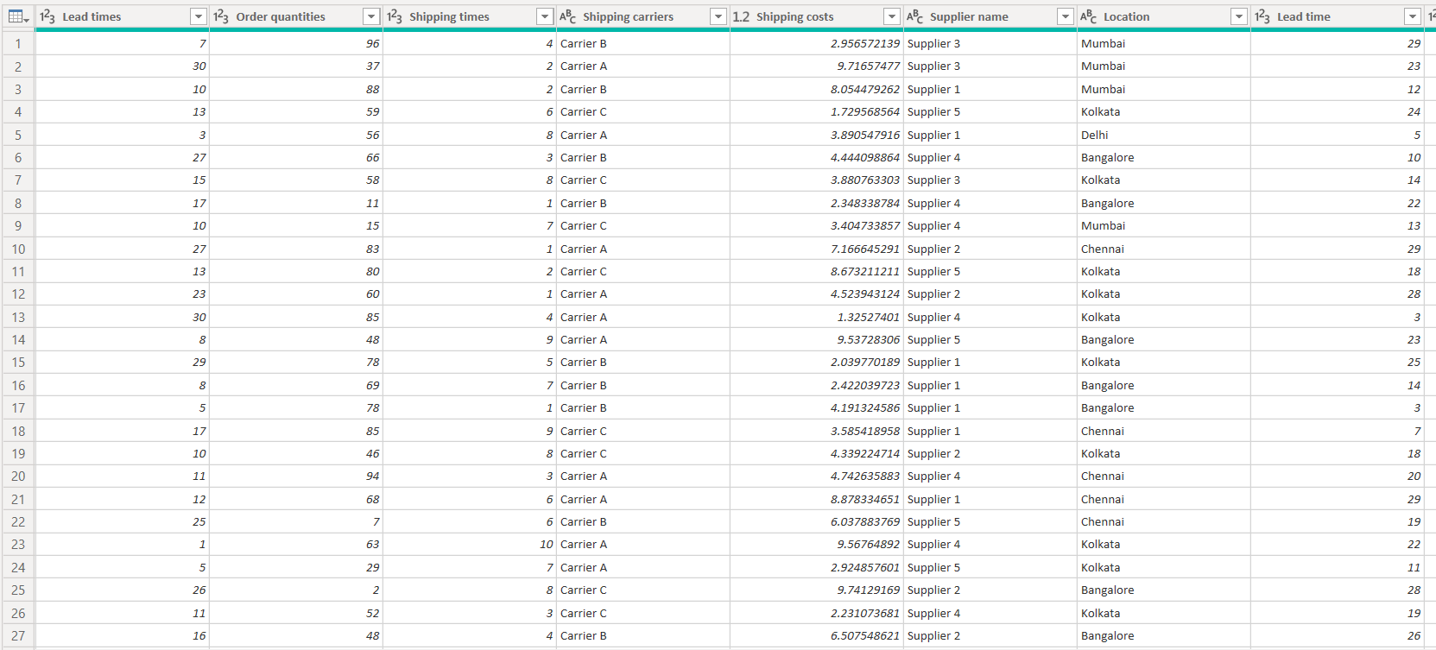

Slide 10
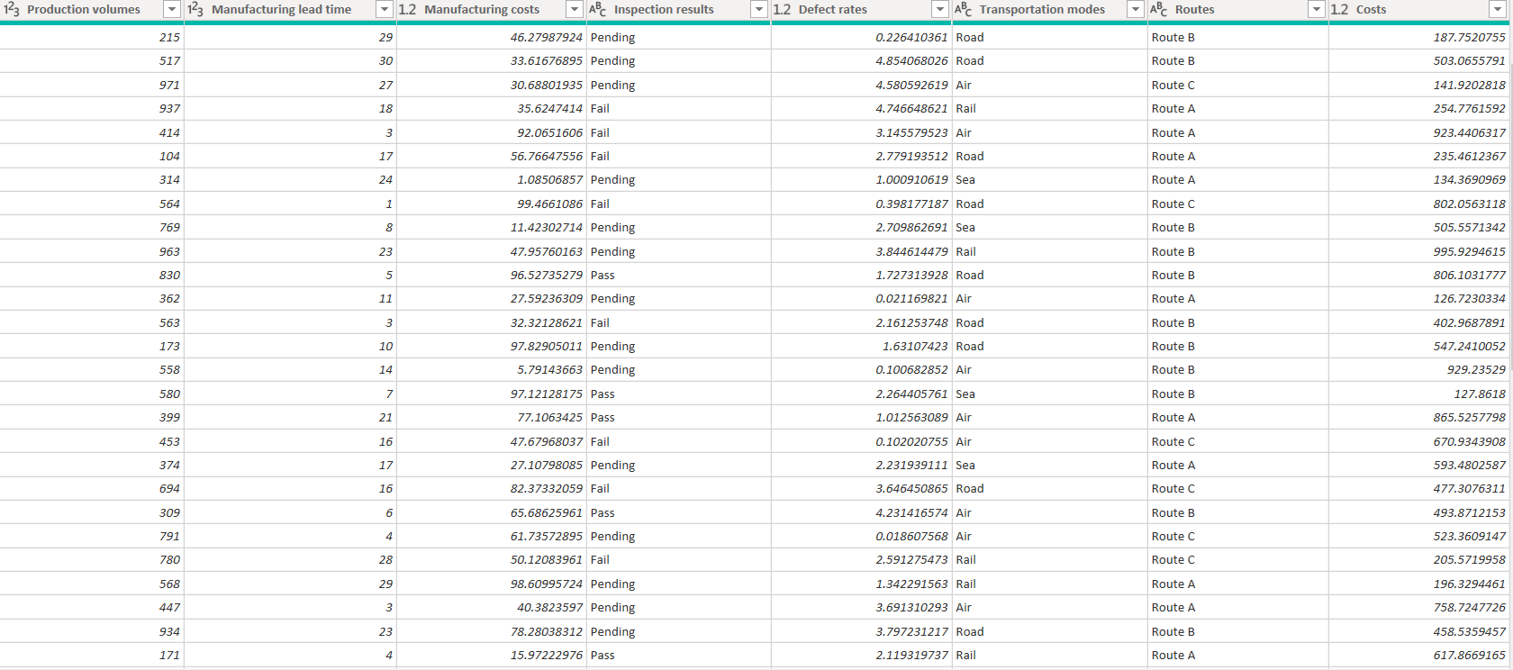

Slide 11
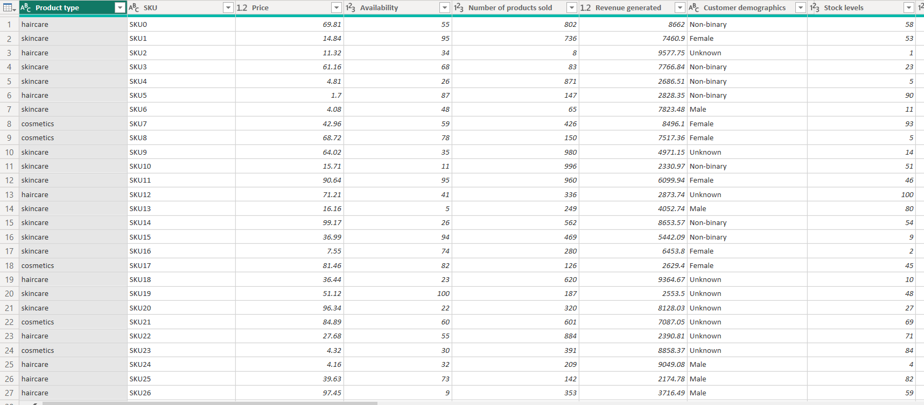
After cleaning

Slide 12
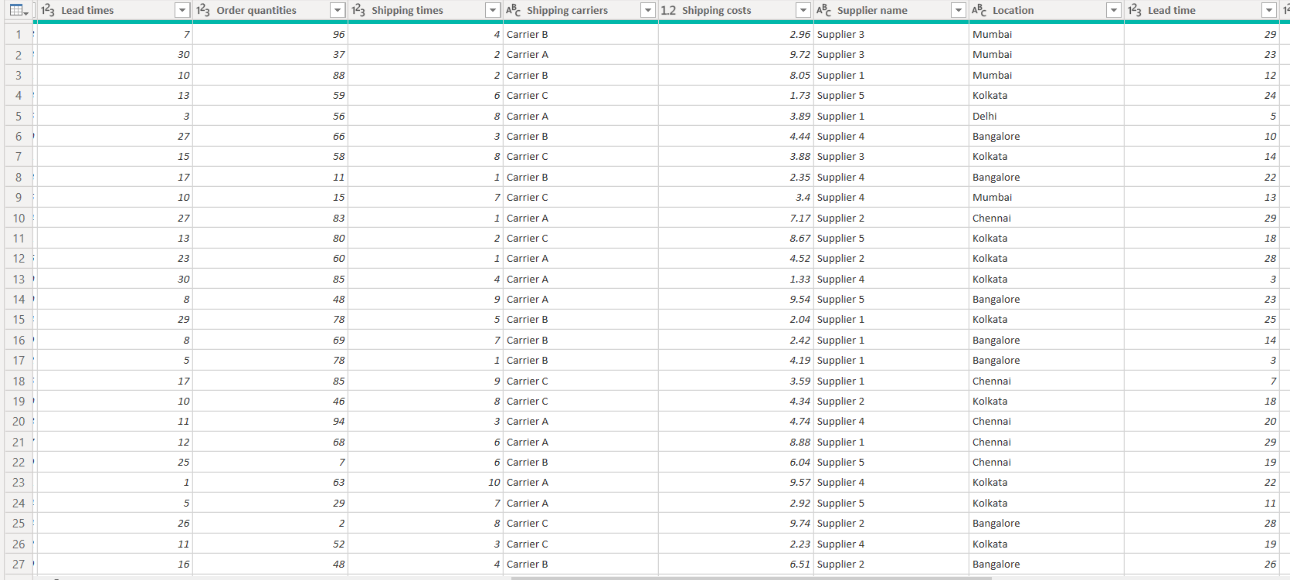

Slide 13
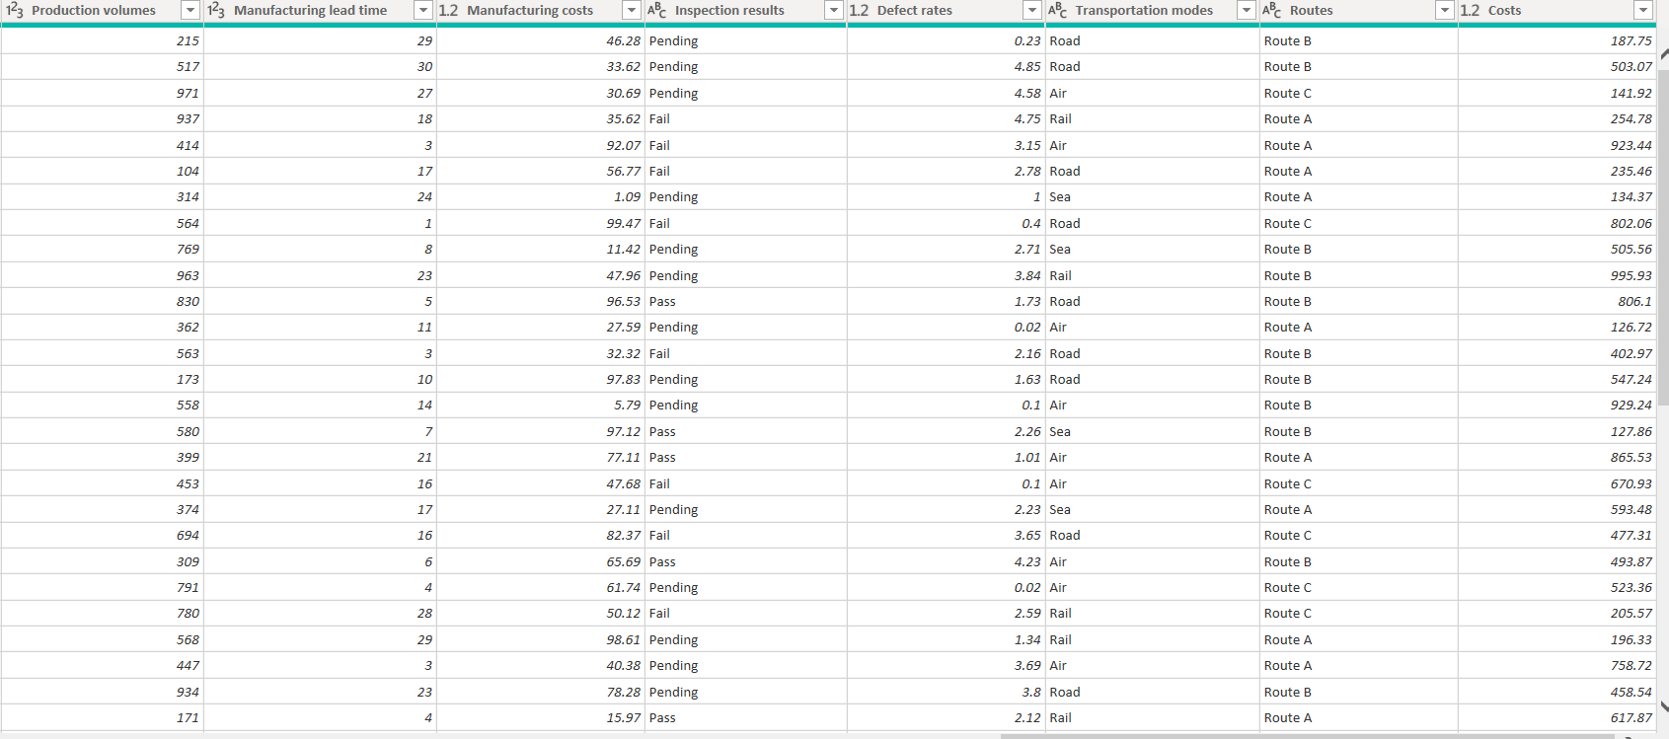

Slide 14
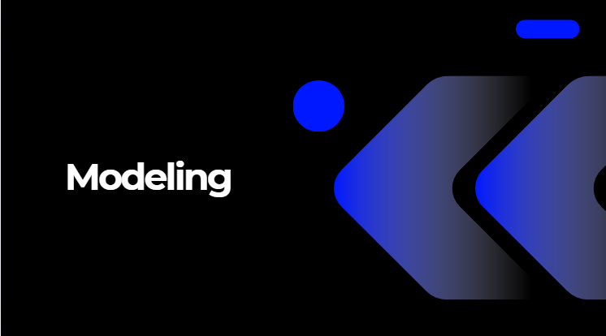

Slide 15
Dataset contains of 1 table , doesn’t need modeling

Slide 16

Stakeholder Analysis

Slide 17
Key Stakeholders
Internal Stakeholders:
Manufacturing – Warehousing – Transportation – Sales ––Top Management
Stakeholder Influence Interest Category
Manufacturing High High Keep Close
Warehousing High High Keep Close
Transportation Medium High Keep Informed
Sales High High Keep Close
Top Management High Medium Keep Satisfied

Slide 18
Stakeholder Roles Across the Supply Chain
Manufacturing: Ensures product availability and production quality.
Warehousing: Manages stock levels and supports efficient order fulfilment.
Transportation: Executes delivery plans and impacts customer satisfaction.
Sales: Connects with market demand and communicates customer needs.
Communication Plan
Weekly meetings: Manufacturing – Warehousing – Transportation-sales
Monthly reports: Top Management

Slide 20
Manufacturing
How many product types are being produced? What is the total production volume? What is the average defect rate across all products? What is the average manufacturing lead time? How does production volume vary based on inspection outcomes? What are the inspection results categorized by product type? What is the average defect rate for each product type? What percentage does each product’s defect rate contribute to the overall defect rate? Is there a correlation between production volume and defect rate? What is the average manufacturing lead time for each product type? | What is the manufacturing lead time and defect rate for each product type? Is there a relationship between manufacturing lead time and production volume? what are the total manufacturing costs? What are the total revenues generated? What is the average manufacturing cost per product type? What is the production volume for each product type? What is the total manufacturing cost associated with each product type? What are the revenues generated by each product type? What are the average revenues and average manufacturing costs for each product type?

Slide 21
Shipping
What is the total shipping cost? What is the average shipping time across all shipments? What is the average shipping lead time? What is the overall average defect rate? Which transportation mode has the highest defect rate? which route gives the best cost /time balance? What is the cost distribution across shipping carriers? How do shipping costs differ across locations? Which supplier is associated with the highest shipping cost? Which routes are used by each supplier, and which route appears to be the most cost-intensive? How do transportation modes differ across the routes, and which mode is associated with the highest shipping cost?

Slide 22
Inventory & storing | Inventory & storing
Stock Levels What is the average stock level for each product? Which products have the highest stock levels, and which have the lowest? Are there any products that have reached critical stock levels (Stock < X)? How do stock levels compare across different product types? Are current stock levels aligned with actual sales performance? | Inventory Turnover What is the inventory turnover rate for each product?(Number of products sold / Stock levels) Which products have the fastest turnover rate? Are there any products considered slow-moving or low turnover ? Is there a gap between sales and current stock levels?

Slide 23
Consumption
What is the average revenue generated during the selected period? What is the total cost compared to the total price? How many customer demographics are represented? How do total costs change over time? How do sales and stock levels vary across different product types? What is the cost distribution by product type? Which product type generates the highest revenue or incurs the highest cost? How are customer costs distributed across different locations? Are there performance differences across product types, locations, or customer segments? Are there any trends or patterns showing increases or decreases in cost or revenue?

Slide 24
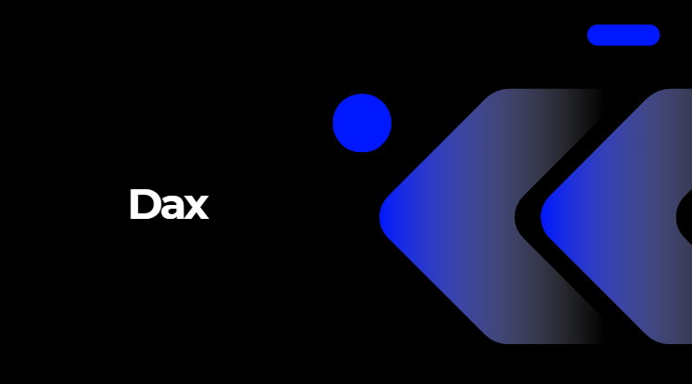

Slide 25
Dax | Type of DAX: | Purpose
Stock Turnover Rate = DIVIDE( SUM('supply_chain_data'[Number of products sold]), SUM('supply_chain_data'[Stock levels]), 0 ) | Aggregation Function (SUM) | This measure calculates the Stock Turnover Rate by dividing the total number of products sold by the total stock levels.It shows how efficiently inventory is being sold, higher values mean products are moving faster.

Slide 26


Slide 27
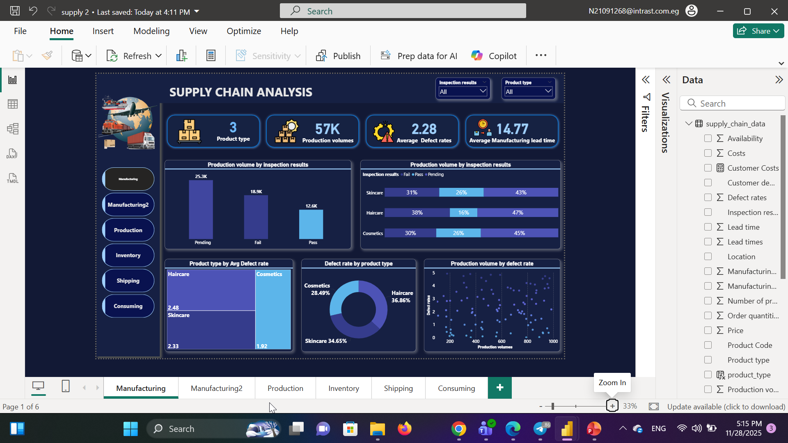

Slide 28
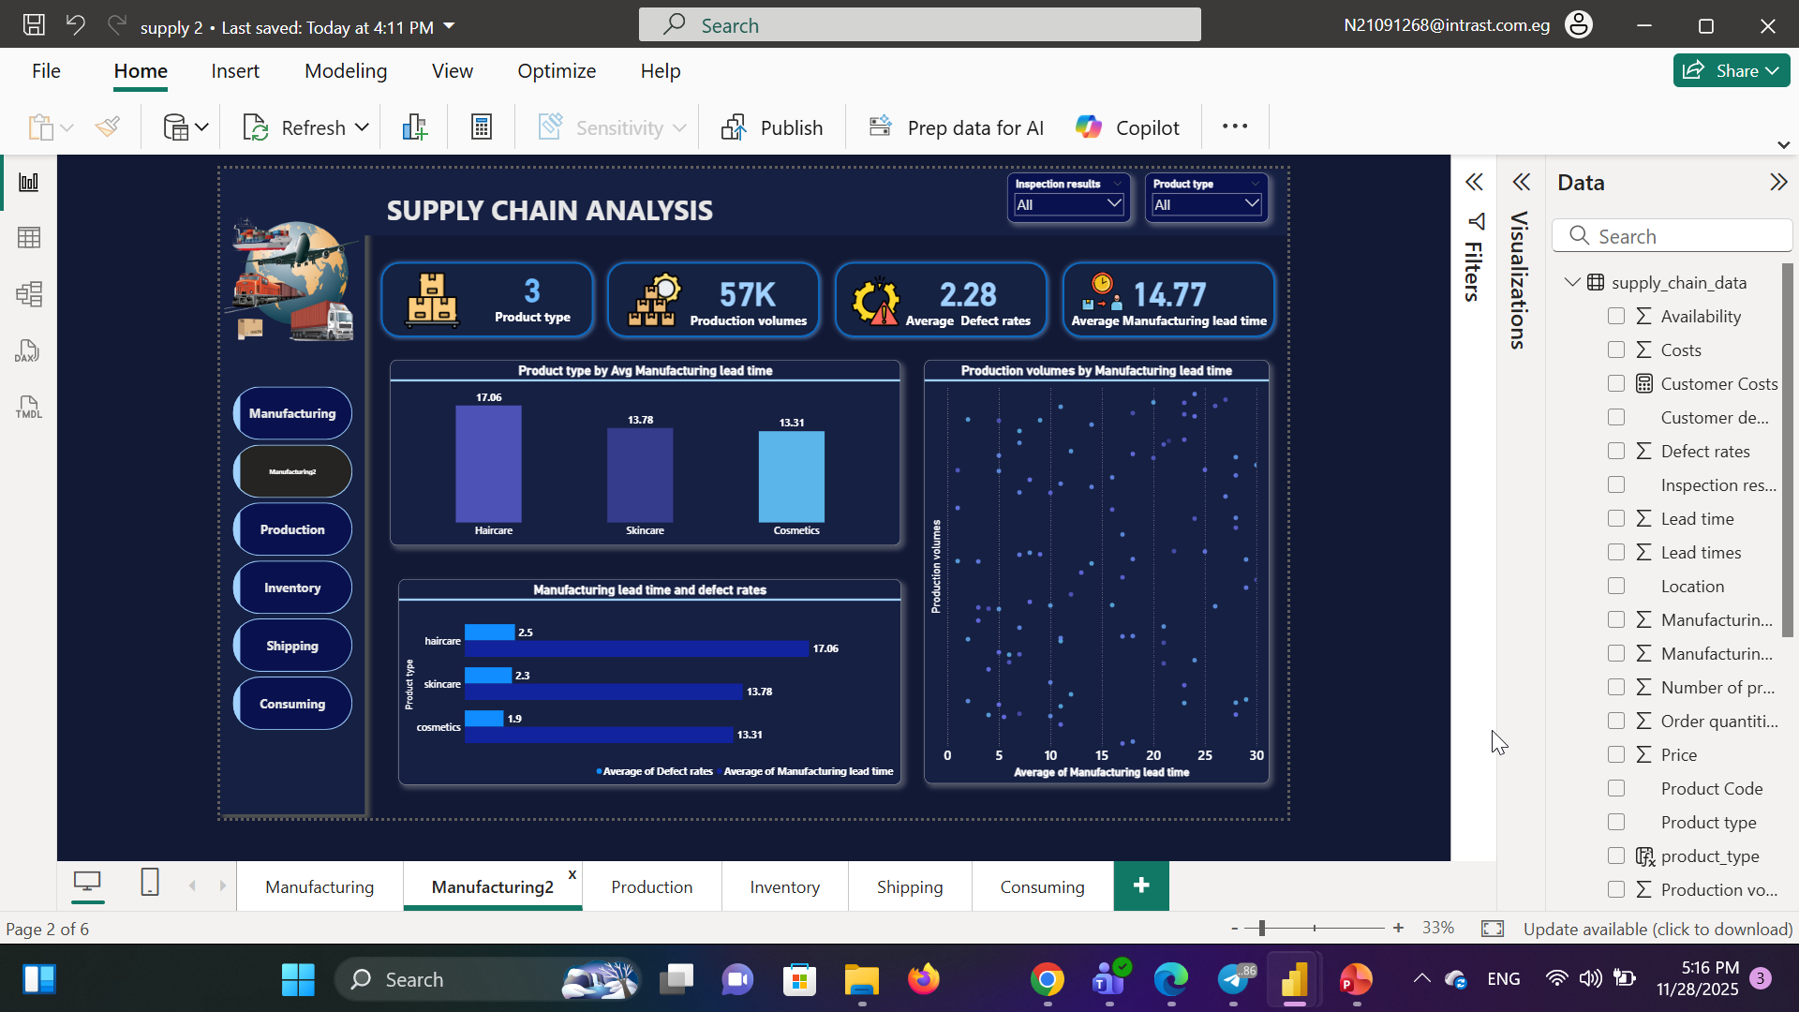

Slide 29
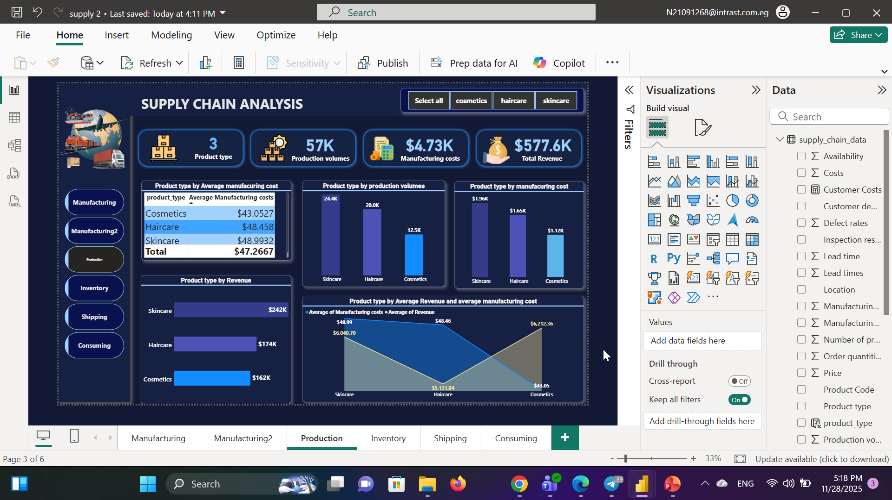

Slide 30
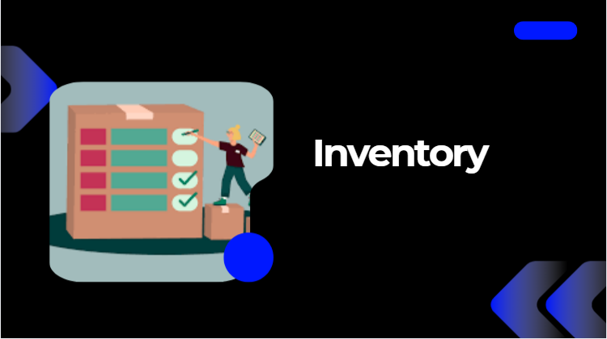

Slide 31
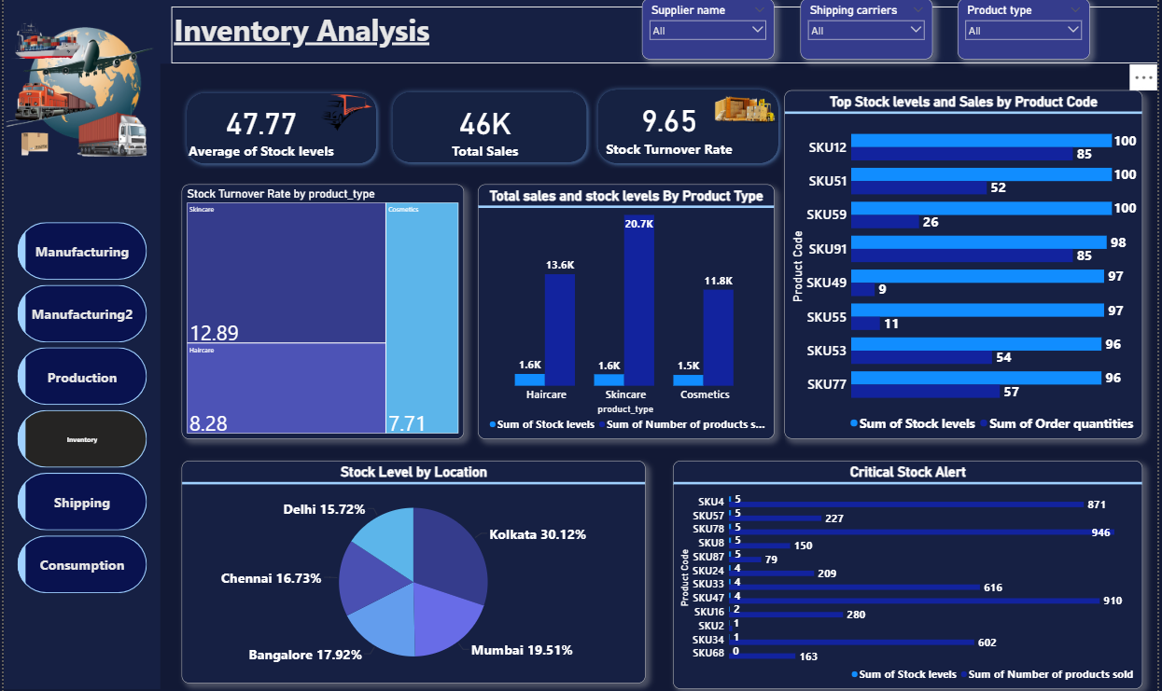
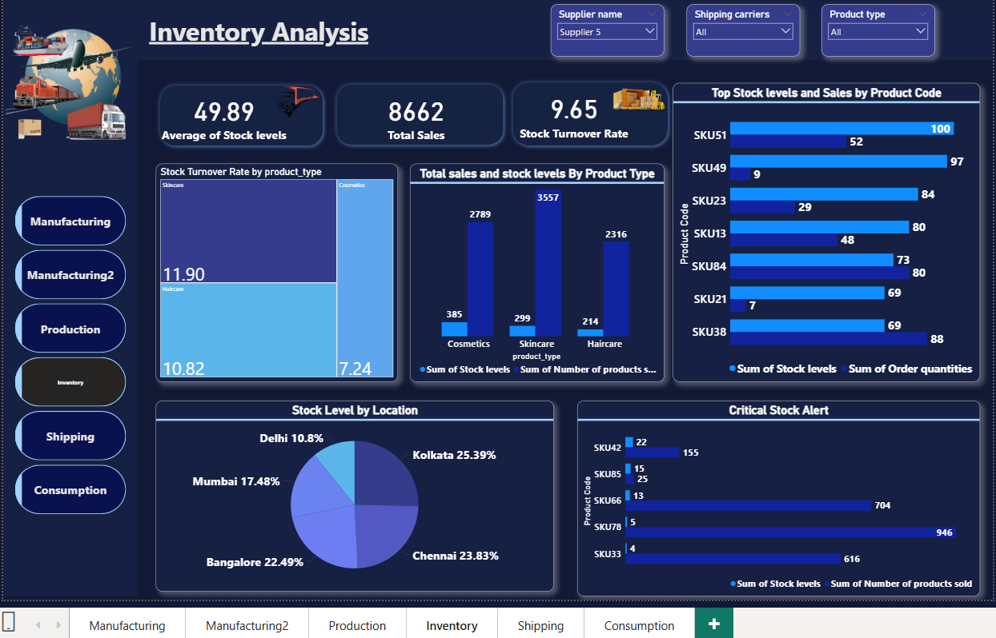

Slide 32
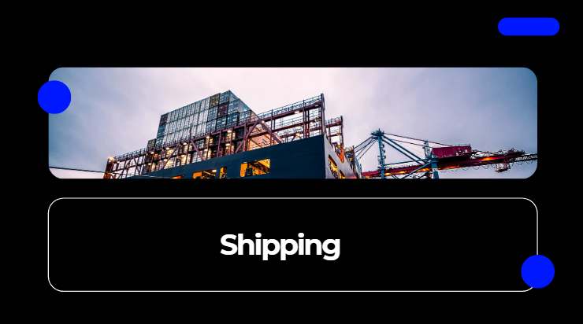

Slide 33
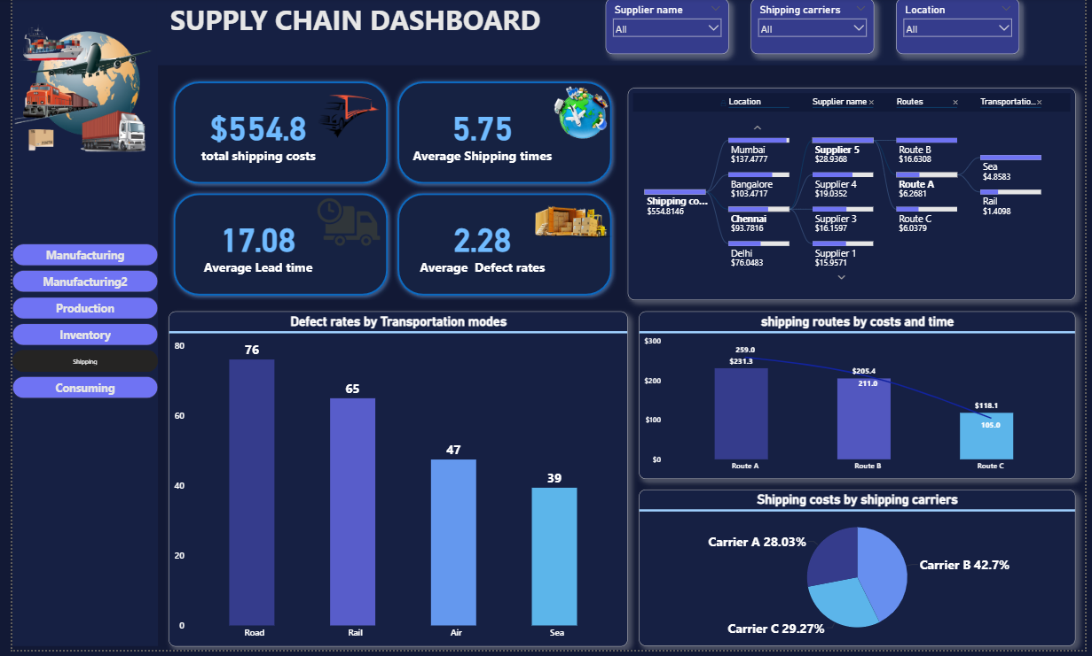

Slide 34
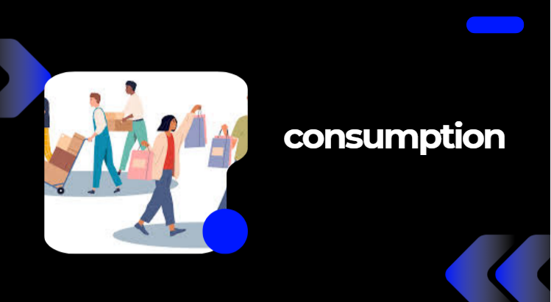

Slide 35
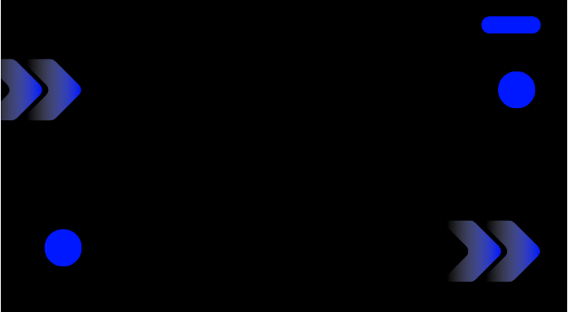
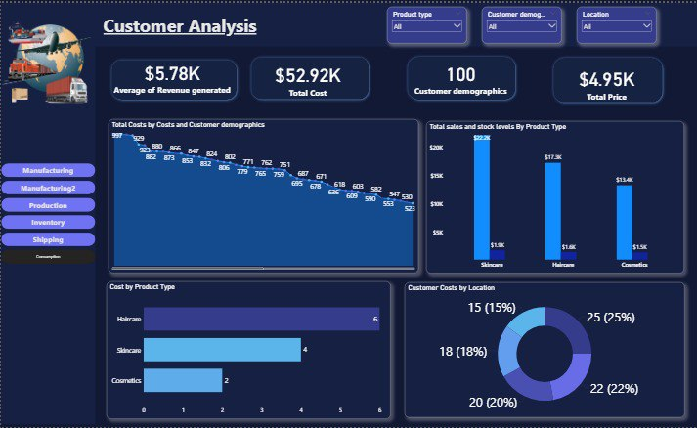

Slide 36
Insights & Recommendations
Manufacturing
The manufacturing process includes three product categories—Skincare, Haircare, and Cosmetics—with a total production volume of 57,000 units. The overall average defect rate is 2.28, and the average manufacturing lead time is 14.77 days. Inspection outcomes show 25,300 pending, 18,900 failed, and 12,600 passed units. The high proportions of pending and failed products highlight a potential quality or process bottleneck that requires further investigation. Haircare products record the highest failure percentage (38%) and only 16% passing, indicating quality concerns that warrant deeper analysis.

Slide 37
Insights & Recommendations
Manufacturing
Haircare also has the highest average defect rate (2.48), which aligns with its elevated failure rates. The highest proportion of defective units is found in Haircare (36.86%), while Cosmetics show the lowest defect percentage (28.49%). Analysis indicates no correlation between production volume and defect rate, meaning defect levels are influenced by factors other than production quantity Haircare products exhibit the highest average manufacturing lead time among all product types.

Slide 38
Insights & Recommendations
Manufacturing
The analysis shows that variations in average manufacturing lead time do not impact production volumes, indicating that production output remains stable regardless of lead-time fluctuations. The maximum lead time recorded is 17.06 days, and this corresponds to haircare products, which also show the highest defect rate 2.5. This suggests that reducing lead time should be prioritized as part of quality improvement efforts. Overall, the increase in average manufacturing lead time does not influence production volumes, confirming that other factors are likely driving output

Slide 39
Insights & Recommendations
Manufacturing
skincare products show the highest average manufacturing cost (48.99), highest production volume (24,400), and highest total cost, while cosmetics have the lowest values. Cosmetics have the lowest manufacturing cost and the highest average revenue, indicating strong profitability and suggesting the need to increase cosmetic production.

Slide 40
Insights & Recommendations
inventory
Inventory Insights Key Metrics Average Stock Level: 47.7 units Total Sales: 46,000 units Stock Turnover Rate: 9.6 Highest Turnover: Skincare – 12.8 Lowest Turnover: Cosmetics – 7.7 Inventory Distribution by City Highest Stock Concentration: Kolkata – 30% of total inventory Lowest Stock Concentration: Delhi – 15% of total inventory This indicates the need to increase stock levels in Delhi, Chennai, and Bengaluru, or redistribute inventory from Kolkata to low-stock locations.

Slide 41
Insights & Recommendations
inventory
Critical Low-Stock Products Several SKUs are in critical stock levels (0–5 units) while having active sales, including: SKU4 – 5 units SKU68 – 4 units SKU24 – 4 units ➡️ Ten items are at immediate risk of stockout. Category Insights Skincare products are the top-selling category, indicating strong demand. Cosmetics products show lower turnover, signaling slower movement.

Slide 42
Insights & Recommendations
inventory
Recommendations: Rebalance Inventory Across Cities Increase stock levels in Delhi, Chennai, and Bengaluru. Reduce excess stock in Kolkata by redistributing to understocked regions. 2. Prioritize Replenishment of Critical SKUs Immediately reorder (or transfer) inventory for SKUs with 0–5 units, especially: SKU4, SKU68, SKU24 Monitor their sales closely and set minimum stock thresholds.

Slide 43
Insights & Recommendations
Shipping
Road transportation has the highest defect rate 76%, making it the least reliable option. So sift high-value shipments to air or sea to reduce returns and defect-related costs. Route A has the highest shipping cost, but also the fastest average shipping time. Use route A only for urgent orders or high-priority shipments. Carrier B represents 42% of total shipping cost - indicating over-dependence on one carrier / Recommendation: negotiate better pricing or diversify carriers to reduce risk and cost concentration. Sea transportation gives the lowest defects(39%)and reasonable cost, making it cost-effective / Recommendation: use sea transportation for non-urgent, bulk, or long-distance shipments. Average lead time : 17.08 days higher than industry standard (10-12days) / Recommendation: optimize supplier performance and remove bottlenecks and road shipments.

Slide 44
Insights & Recommendations
Consumptions
Revenue is much lower than total cost, showing low profitability. Skincare has the highest sales, followed by Haircare, then Cosmetics. Customer costs are not evenly distributed across locations. Total costs are showing a steady decline over time. The customer base is large, but revenue per customer is low. Re-evaluate product pricing to improve profitability. Adjust inventory based on demand (increase Skincare stock, reduce Cosmetics). Use region-specific marketing strategies to boost performance. Increase Customer Lifetime Value (CLV) using loyalty programs and personalized offers. Analyze the reasons behind declining costs and apply best practices across operations. Use customer segmentation to improve targeting and marketing effectiveness

Slide 45
